Slide 1
Fidessa BlueBox Asian Strategies
Last updated September 2013 BBMA v13.3.0

Slide 2
Introduction
Fidessa BlueBox Asian Strategies offer a total of thirteen models:
TWAP HK, TWAP SG
VWAP HK, TWAP SG
POV HK, POV SG
Manual TWAP
Iceberg AP
Sniper AP
Hidden AP
Assassin AP
Passive AP
ShortSell AP
Market
Implementation Shortfall HK, Implementation Shortfall SG
Market on Close HK, Market on Close SG
Traders should determine which strategy to use base on user preferences and order instructions.

Slide 3
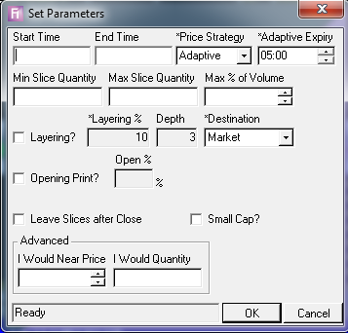
TWAP HK, TWAP SG
The TWAP HK model trades an order evenly over time with a reduced footprint through
randomization of time and quantity
Parameters
Start Time Max % of Volume
End Time Layering?
Price Strategy Layering %
Adaptive Expiry Depth
Min Slice Quantity Destination
Max Slice Quantity Opening Print?
Open %
I Would Near Price
I Would Quantity
For TWAP SG only: For TWAP HK only:
Closing Print? Leave Slices after Close
Close % Small Cap?

Slide 4
Slice Quantity
Slice quantity will be picked by the BlueBox randomly between Min and Max Slices Quantity
Min and Max Slices Quantity can be entered manually
If Min and Max are blank, BlueBox will calculate the Min and Max values using the formula below
Min Slice Quantity
½(Order Volume) / (Target Number of Slices)
Max Slice Quantity
3/2(Order Volume) / (Target Number of Slices)
Where
Target number of Slice = (190 lots)T/300
T = Duration of time
Calculated Min and Max quantity will adjust automatically base on the outstanding order volume
Trading large order volume in short period of time may result in large calculated Min and Max slice quantity
Small Max slice quantity that entered manually will result in shorter time interval between each slice
The constant lot size 190 will be reviewed by Fidessa every quarter of a year

Slide 5
Price Strategies
There will be four pricing strategies for pricing TWAP slices, they are:
PASSIVE
ADAPTIVE
AGGRESSIVE
SHORTSELL (For TWAP HK only)
PASSIVE
TWAP Slices will be priced at the best passive price
When the slice expiry time is reached and the passive slice is not fully filled, BlueBox will pull the slice back, and place a new one a consolidated quantity
For order which takes PASSIVE price strategy, at the last 15 mins before the end time, the algorithm switches the strategy to ADAPTIVE

Slide 6
Price Strategies
ADAPTIVE
TWAP slices will be priced which are calculated by BlueBox with the formula below:
pTRt/T + (1-p)TR
Where
Book pressure (p) = (Total Aggressive volume)/(Total Passive Volume), and the
value will be capped at ½ and 2 respectively
Tick Range (TR) = Average spread (AS)*2 Base Tick Size (BTA)
t = Time remained in slice level
T = Slice lifetime
Using the adaptive formula, BlueBox will determine the price base on market condition at each slice creation time
Adaptive price will change when the market variables in the formula changed.
10 seconds before the adaptive slice expired, the slice will amend to an Enhance Limit Order with 4 limits capped by client limit price, in order make sure the slice is fully filled.

Slide 7
Price Strategies
AGGRESSIVE
TWAP Slices will be priced at the aggressive price
Theoretically, the slice should be executed immediately given there is liquidity available
NOTES
Each slice price will be capped if there is a limit price specified in the order regardless of which price strategy is used
User should determine what price strategy to use base on market movement, order instruction and the liquidity of individual stock
Under Passive pricing, queuing priority will be lost when slice expiry is reached and BlueBox pulls the slice back from the market
Under Passive and Adaptive pricing, the longer the ‘Adaptive Expiry’ is, the longer the TWAP slices stay passive
Under Passive and Adaptive pricing, TWAP slices will potential be priced at the same price at the same time.

Slide 8
Price Strategies
SHORTSELL (For TWAP HK only)
TWAP HK Slices will be peg with passive touch price
Being re-priced once passive touch price becomes more aggressive
Slices stay on market until the algo ends
NOTES
This pricing strategy does not aim to complete the order, however, it can be considered as an advanced version of ShortSell algo and tries to react to passive touch price proactively

Slide 9
Layering
The Layering function puts a pre-determined percentage of the order on the passive side of the public order book, with a pre-determined level of depth.
The layering quantity that is placed on the each level will be in proportion to the queued volume.
It is designed to improve the average price of the order
Layering quantity in each depth will be in proportion to the queued volume
Layering slices will refill every 30 minutes.
If any of the layering slices got executed, it will be very likely to cause the TWAP order to trade ahead the schedule. In this case, TWAP will wait until the traded volume is back in the schedule
There will be 10% buffer for order volume, which means if 10% of the order is used for layering, it will stop layering when the order is 90% executed, if 20% is used for layering, the order stops when it is 80% executed.
When ‘Max Pct of Volume’ is reached, LIVE Layering slices will not be pulled back from the exchange, but it will stop creating new layering slices and amend LIVE slices if any of the LIVE slices got executed
NOTES
TWAP Orders may potentially be traded ahead of schedule if any of the layering slices got executed
TWAP Orders may potentially be completed earlier as layering slices refill when they got executed

Slide 10
Opening Print
Opening Print allows the BlueBox order to participate in morning auction period.
When Opening Print is ticked, the Open% can be specified. This will be the % of the order volume user wants to put into participating in the morning auction period.
The order type of auction slices (market/limit) follows the order type of the BlueBox order.
Entering an Open% during the continuous session will not have an effect on the BlueBox order.

Slide 11
I Would Option
“I Would” option allows the BlueBox order to place opportunistic slices of pre-defined size in the market for price improvement purpose when the price reaches certain criteria.
At any time, if the order is a buy/sell and the “I Would Near” price is greater/less than or equal to current offer/bid, it sends out an IOC slice with “I Would Quantity” or the remaining quantity if “I Would Quantity” is not provided.
It would continue until the “I Would Near” price condition is no longer met or until the order is fully filled.
For HKG orders, the Enhance Limit rule is also respected.

Slide 12
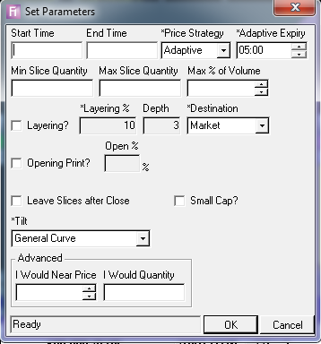
VWAP HK, VWAP SG
Trade according to an expected volume curve up to a maximum % of volume participation.
Parameters
- Start Time Layering %
- End Time Depth
- Price Strategy Destination
- Adaptive Expiry Opening Print?
Min Slice Quantity Open %
Max Slice Quantity Leave Slice After Close
Max Pct of Volume I Would Near Price
Laying? I Would Quantity
- Tilt
For VWAP SG only: For VWAP HK only:
Closing Print? Small Cap
Close %

Slide 13
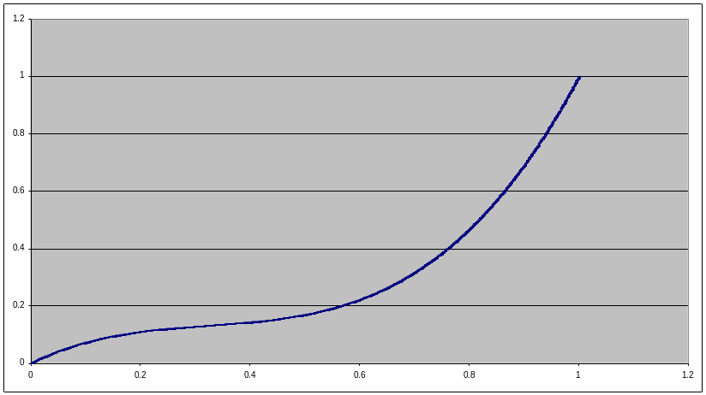
Volume Curve
Currently, the General Curves is available in VWAP.
General Curve: default volume curve, same for every instrument
NOTES
Traders should determine which curve to use base on user preference and market movement.
General Curve

Slide 14
Slice Quantity
VWAP HK shares the same slice quantity control mechanism as TWAP HK
Slice quantity will be picked by the BlueBox randomly between Min and Max Slices Quantity
Min and Max Slices Quantity can be entered manually
NOTES
Calculated Min and Max quantity will adjust automatically base on the outstanding order volume
Manual entered Min and Max quantity will not adjust automatically
Trading large order volume in short period of time may result in large calculated Min and Max slice quantity
Small Max slice quantity that entered manually will result in shorter time interval between each slice
The constant lot size 190 will be reviewed by Fidessa every quarter of a year

Slide 15
Price Strategies
There will be three pricing strategies for pricing TWAP slices, they are;
PASSIVE
ADAPTIVE
AGGRESSIVE
NOTES
Each slice price will be capped if there is a limit price specified in the order regardless of which price strategy is used
User should determine what price strategy to use base on market movement, order instruction and the liquidity of individual stock
Under Passive pricing, queuing priority will be lost when slice expiry is reached and BlueBox pulls the slice back from the market
Under Passive and Adaptive pricing, the longer the ‘Adaptive Expiry’ is, the longer the VWAP slices stay passive
Under Passive and Adaptive pricing, VWAP slices will potential be priced at the same price at the same time

Slide 16
Layering
The Layering function puts a pre-determined % of the order on the passive side of the public order book, with a pre-determined level of depth.
The layering quantity that is placed on the each level will be in proportion to the queued volume.
NOTES
VWAP Orders may potentially be traded ahead of schedule if any of the layering slices got executed
VWAP Orders may potentially be completed earlier as layering slices refill when they got executed

Slide 17
Opening Print
Opening Print allows the BlueBox order to participate in morning auction period.
When Opening Print is ticked, the Open% can be specified. This will be the % of the order volume user wants to put into participating in the morning auction period.
The order type of auction slices (market/limit) follows the order type of the BlueBox order.
Entering an Open% during the continuous session will not have an effect on the BlueBox order.
I Would
The VWAP algorithm has the same functionality of “I Would” option as TWAP.

Slide 18
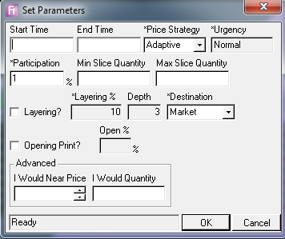
POV HK, POV SG
A volume-driven strategy designed to participate in-line with the traded volume inside of a customer or
trader limit price
Parameters
- Start Time - Layering?
- End Time - Layering%
- Price Strategy - Depth
- Participation % - Destination
- Min Slice Quantity - Open Print?
Max Slice Quantity - Open %
        - I Would Near Price
        - I Would Quantity

Slide 19

Slicing Rate and Quantity
The POV model uses the following formula to determine how much quantity it needs to place on the market:
Where
P is the Participation % parameter.
FilledQuantity is the amount of the order filled by POV and is calculated since the algorithm started, or restarted. It includes quantity already split on the market by the POV algorithm but not yet filled.
CumVolume is the cumulative volume of all trades that have occurred on the market within the order's limit price (or within the limit defined in the Trader Limit parameter) since the algorithm started. This volume does not include volume done in the auction period. The POV algorithm only runs during continuous trading sessions. If it is started during or before the morning auction session then the start time is amended to be the start of first continuous trading period. CumVolume is then calculated relative to the start of the morning continuous session.
NOTES
There will be 1% tolerance on the participation rate, as BlueBox will round all slices up to the nearest lot size
BlueBox will stop creating POV slice if the order has traded ahead of the participation rate

Slide 20
Slice Quantity
POV HK shares the same slice quantity control mechanism as TWAP HK and VWAP HK
Slice quantity will be picked by the BlueBox randomly between Min and Max Slices Quantity
Min and Max Slices Quantity can be entered manually
NOTES
Multiple slices will be created if POV slices are required to generated with a quantity greater than the Max quantity
The constant lot size 190 will be reviewed by Fidessa every quarter of a year

Slide 21
Price Strategies
There will be Two pricing strategies for pricing POV slices, they are;
ADAPTIVE (Same as the adaptive pricing for TWAP HK and VWAP HK)
AGGRESSIVE (Same as the aggressive pricing for TWAP HK and VWAP HK)
NOTES
Each slice price will be capped if there is a limit price specified in the order regardless of which price strategy is used
User should determine what price strategy to use base on market movement, order instruction and the liquidity of individual stock
Under Adaptive pricing, POV slices will potential be priced at the same price at the same time

Slide 22
Layering
The Layering function puts a pre-determined % of the order on the passive side of the public order book, with a pre-determined level of depth.
The layering quantity that is placed on the each level will be in proportion to the queued volume.
Layering quantity in each market depth will be calculated using the Participation rate, if Participation rate is set to 10%, then layering quantity in each market depth will be capped by 10% of the queued volume.
NOTES
POV Orders may potentially be traded ahead of schedule if any of the layering slices got executed
POV Orders may potentially be completed earlier as layering slices refill when they got executed

Slide 23
Opening Print
Opening Print allows the BlueBox order to participate in morning auction period.
When Opening Print is ticked, the Open% can be specified. This will be the % of the order volume user wants to put into participating in the morning auction period.
The order type of auction slices (market/ limit) follows the order type of the BlueBox order.
Entering an Open% during the continuous session will not have an effect on the BlueBox order.
I Would
The VWAP algorithm has the same functionality of “I Would” option as TWAP.

Slide 24
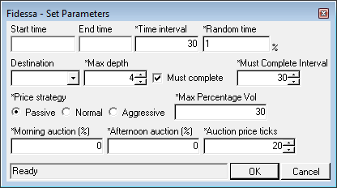
Manual TWAP
The purpose of the Manual TWAP (Time Weighted Average Price) model is to split a large order into
several smaller, equally-sized slices and trade them across an allotted time period. These slices are
placed on the market at a user - defined frequency until the order has been filled
Parameters
- Start time - Morning Auction (%)
- End Time - Auction Price ticks
- Price Strategy - Max Depth
- Time Interval - Must Compete Interval
- Must Complete - Destination
Max Percentage Vol
For SG only:
Afternoon auction (%)

Slide 25
Functionalities
Target no. slice = (Start time – End time) / Time interval
Slice volume = Order volume / Target no. slice
Max Depth – maximum slices in the market at a time and the maximum no. of depth that TWAP slices will be priced
Must Complete - determine whether slices will go aggressive when End Time is about to be reached
Must Complete Interval – time interval before the end time when Must Complete starts [ End time - (must complete value*max depth value)]
Price Strategy NORMAL – New slice created will go aggressive after the Max Depth is reached
Market movement – With any market movement, queued slices will follow within 3s, and it starts with the slice with the worst price

Slide 26
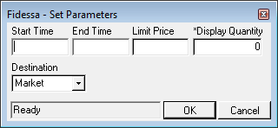
Iceberg AP
Sends a slice to the market in display quantity at order limit price.
Once the quantity on the market has been fully filled, the engine sends another slice
of the same display quantity.
Parameters
- Start time - Destination
- End Time
- Limit Price
- Display Quantity

Slide 27
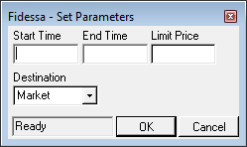
Sniper AP
The model does not post any liquidity – It keeps the entire quantity of the order hidden from the
market. It only sends Special Limit Order on the aggressive side as soon as the best opposite is equal to
the limit price.
Parameters
- Start time - Destination
- End Time
- Limit Price
NOTES
‘Unsolicited Cancel’ warning is expected from the HKEx if the Special Limit order cannot be fully filled immediately

Slide 28
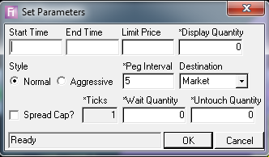
Hidden AP
Sends a portion of the total order quantity at the passive side (display quantity) and peg it to remain at
the first limit; best bid (if buy) or best offer (if sell). Once the best opposite price is equal or more
favourable than the limit of the parent order, the algorithmic engine crosses the spread and grab the
available liquidity.
Parameters
- Start time - Destination
- End Time - Spread Cap?
- Limit Price - Ticks
Display Quantity - Wait Quantity
Style - Untouch Quantity
- Peg Interval

Slide 29
Style
Normal Style
An iceberg slice will be created and pegged at the most passive price
If the aggressive price is equal or better than the limit price, an SLO slice with the outstanding order quantity will be sent.
The iceberg slice will still be pegged at the passive price after the crossing the spread
Aggressive Style
An iceberg slice will be created and pegged at the most passive price
If the aggressive price is equal or better than the limit price, an SLO slice with the outstanding order quantity will be sent.
The iceberg slice will no long be pegged at the passive price, it will also cross the spread for execution
NOTES
‘Unsolicited Cancel’ warning is expected from the HKEx if the Special Limit order cannot be fully filled immediately

Slide 30
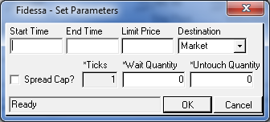
Assassin AP
The Assassin model, like the Sniper model, keeps the entire quantity of the order hidden from the market. This model supports the spread control parameters. Is is intended for instruments with low liquidity, where crossing the spread typically involves high cost.
Parameters
- Start time - Destination
- End Time
- Limit Price
Spread Cap?
Ticks
Wait Quantity
Untouch Quantity

Slide 31
Spread Control
Spread Cap
Not cross the spread if the spread is larger than N ticks (user-specified), even if the aggressive price is within the price limit, to avoid paying high liquidity premium.
Wait Quantity
Wait for execution of certain quantity (user-specified) to occur at the aggressive price before crossing the spread, to avoid being tricked
Untouch Quantity
Leave the spread unchanged by leaving Some quantity (user-specified) untouched while grabbing as much liquidity as possible within the price limit, to lower impact to the market.

Slide 32
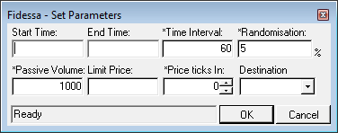
Passive AP
The purpose of the model is to try fill an order using only passive trades. It places two
order slices onto the market, the first is placed at the top, and the second slice will be
priced one tick out from the first one.
Parameters
- Start time - Price Ticks In
- End Time - Destination
- Time Interval
- Randomisation
- Passive Volume
Limit Price

Slide 33
Functionalities
Create 2 slices and pegged at the first and second passive price right after the order is placed into BlueBox
If the first slice got executed, the second slice will move up.
BlueBox will create passive slice base on ‘Time Interval’

Slide 34
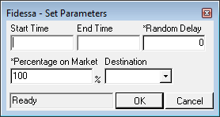
ShortSell AP
Most exchanges that support short-selling enforce extra rules on short sell orders to prevent the price of a stock from dropping too rapidly. Each market has different rules that define the minimum legal short-sell price. Any orders that breach these rules are immediately released from the exchange.
The purpose of the ShortSell model is to maintain an order on the market at the minimum legal short-sell price (provided this is within any applicable order or trader limits).
Parameters
- Start time
- End Time
- Random Delay
- Percentage on Market
Destination

Slide 35
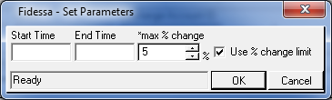
Market
The Market model aims to simulate the Market order type for Exchanges that do not support it natively, such as the HKG.
The Market model allows the order to drill down the market depth and get executed at the current market price and, at the same time, provide the trader with additional control of the maximum allowable percentage change to the market price.
Parameters
- Start time
- End Time
- Max % change
- Use % change limit

Slide 36
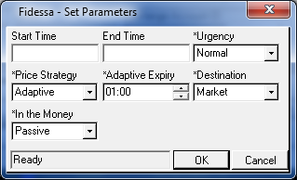
Implementation Shortfall HK, SG
The Implementation Shortfall algorithm works an order that is benchmarked against the Arrival price. It achieves this by slicing the order according to an optimal trading trajectory, in order to balance market impact due to rapid execution against the price risk of slow execution.
The Implementation Shortfall model creates larger slices a first, then smaller slices as the order is filled. The rate of trading is dependent on stock volatility, stock spread with respect to price, and user-indicated urgency level. The model also incorporates a volume curve so that it trades relatively faster at times of the day when market impact is relatively smaller.
Parameters
- Start time - Destination
- End Time - In the Money
- Urgency
- Price Strategy
Adaptive Expiry

Slide 37
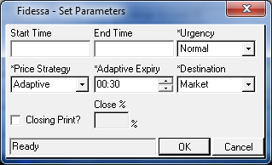
Market on Close HK, SG
The Market on Close algorithm works an order that is benchmarked to the Close price or the price at a specified end time. The trader is able to specify via parameters his /her relative tolerance to market impact versus price risk. This model then slices the order progressively into the end time so as the balance market impact cost with the price risk of missing the close price.
the Market on Close model creates smaller slices at first, then larger slices as the order is filled. The rate of trading is dependent on stock volatility, stock spread with respect to price, and user-indicated urgency level.
Parameters
- Start time - Destination
- End Time - Closing Print?
- Urgency - Close %
- Price Strategy
Adaptive Expiry

